Slide 2
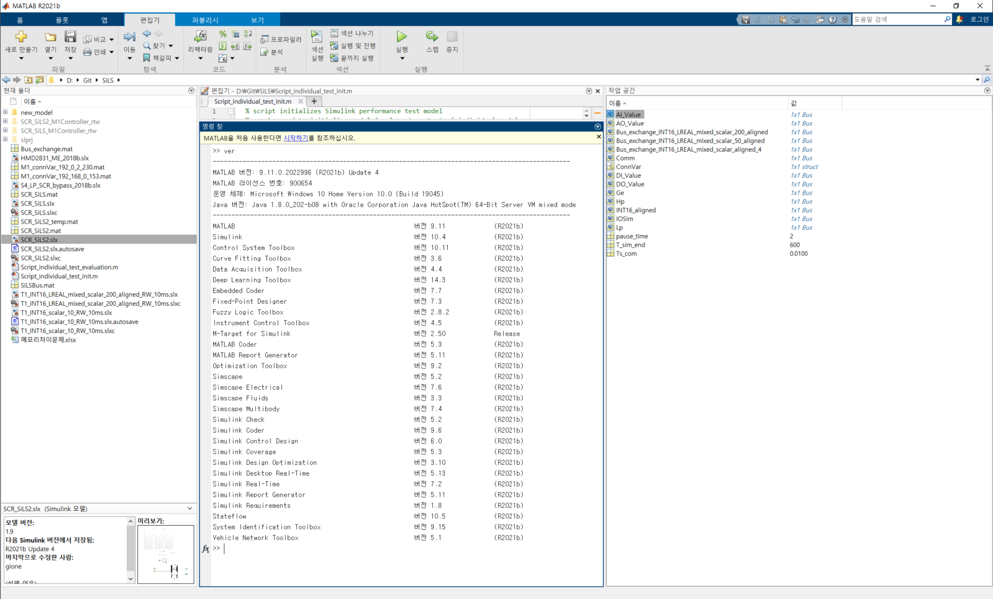
Version

Slide 3
Case 1) System configuration of the SiLS in the PLC
Bachmann PLC
(MC212)
NONOXR4
NONOXR4: SCR Control software
IOSim: data structure for simulation
IOSim
SiLS
SiLS: SCR simple model, which is operated in the PLC

Slide 4
IOSim structure information
IOSim
– Comm : common interface module
–AI[0~3] : AI_0, AI_1,~~
- AO[0~3] : AO_0, AO_1~~~
- DI[0~3] : DI_0, DI_1, ~~
- DO[0~3] : DO_0, DO_1, ~~~
– HP : HP engine interface module
–AI[0~3] : AI_0, AI_1,~~
- AO[0~3] : AO_0, AO_1~~~
- DI[0~3] : DI_0, DI_1, ~~
- DO[0~3] : DO_0, DO_1, ~~~
– LP : LP engine interface module
–AI[0~3] : AI_0, AI_1,~~
- AO[0~3] : AO_0, AO_1~~~
- DI[0~3] : DI_0, DI_1, ~~
- DO[0~3] : DO_0, DO_1, ~~~
– GE1~GE8 : Generate engine interface module
–AI[0~3] : AI_0, AI_1,~~
- AO[0~3] : AO_0, AO_1~~~
- DI[0~3] : DI_0, DI_1, ~~
- DO[0~3] : DO_0, DO_1, ~~~
matlab can’t using array structure, so IO module is defined as a separated unit such like AI_0, AI_1~~AI_3
But if I can using array in the bachmann PLC, then I will using them(X20IOSim).
The original data structure is X20IOSim.

Slide 5
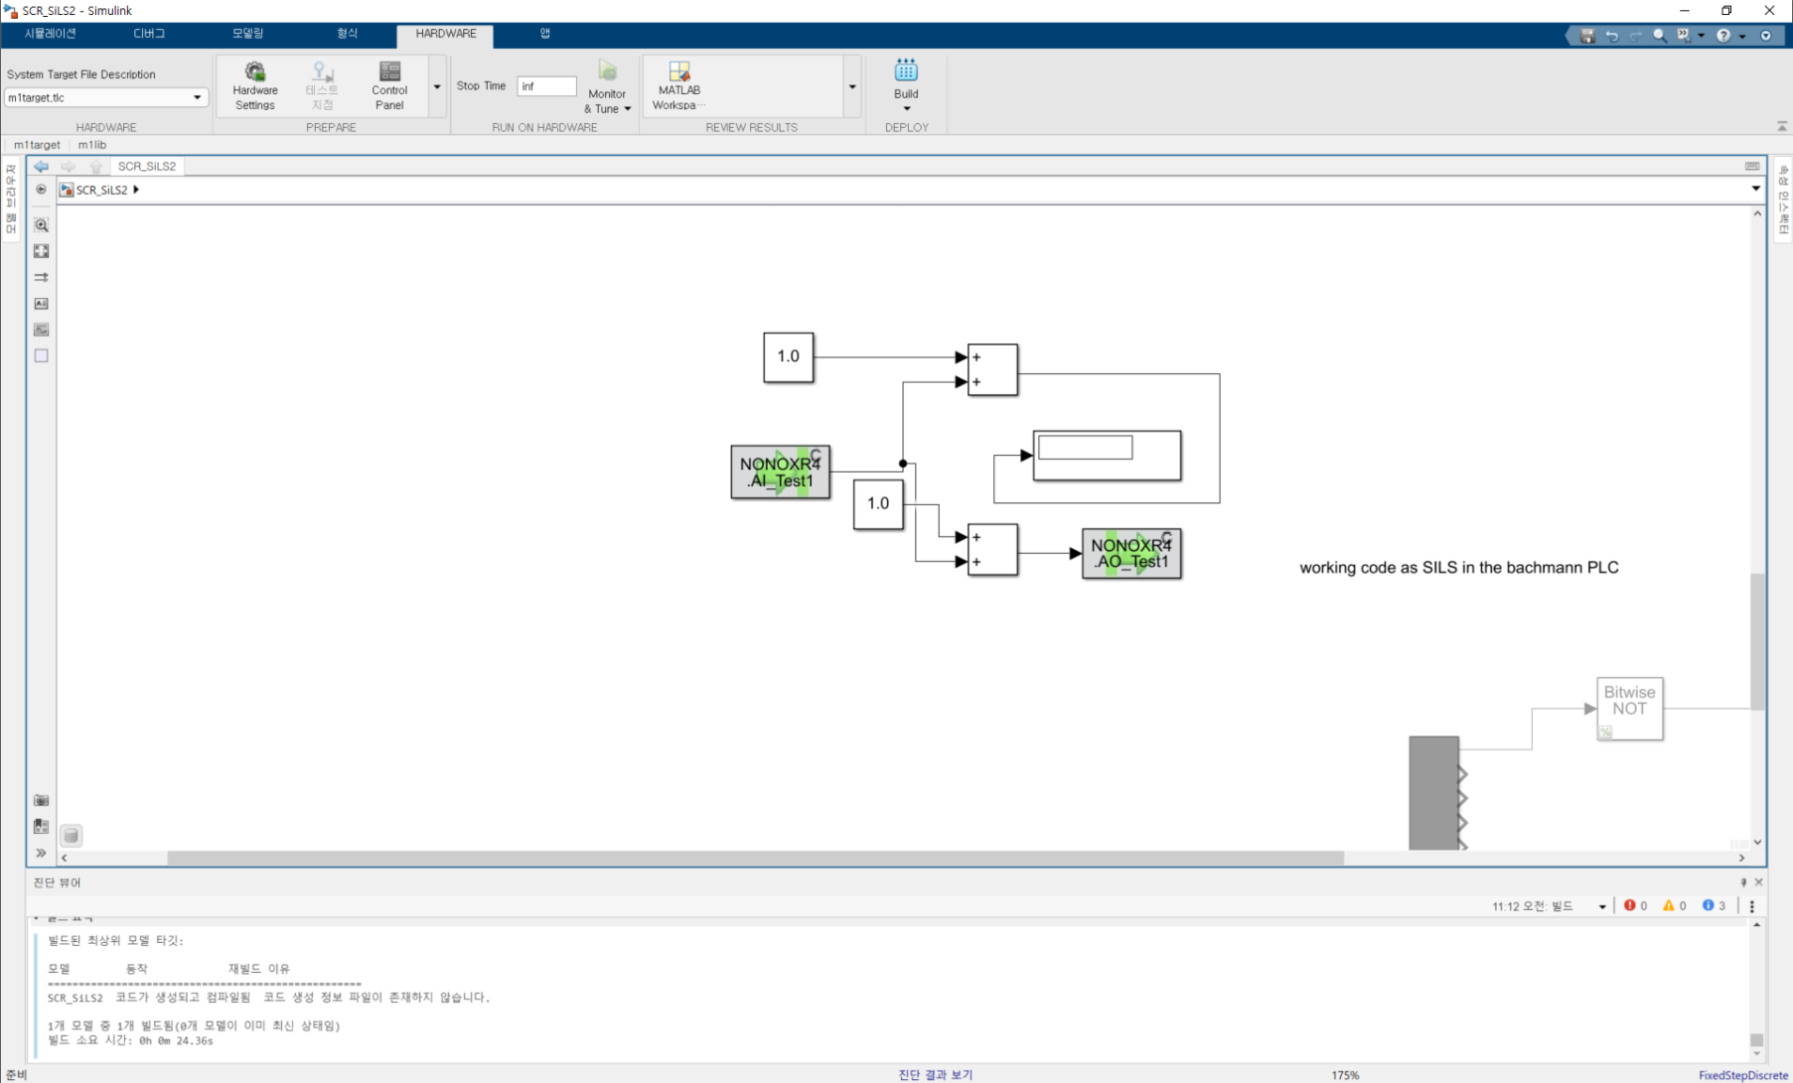
Sample program-SCR_SiLS

Slide 6
Case 2) System configuration of the SiLS in the PLC
Bachmann PLC
(MC212)
NONOXR4
NONOXR4: SCR Control software
IOSim: data structure for simulation
IOSim
Simulation
Simulation: SCR simple model, which is operated in the PC program
Simulink in the PC

Slide 7
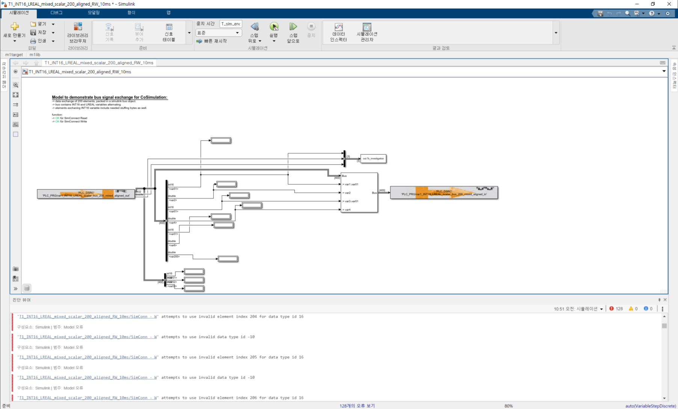
Sample program-T1_INT16_LREAL_mixed_scalar_200_aligned_RW_10ms Is it right application??

